Slide 1

Automation in Hair Wig Manufacturing
INDIAN INSTITUTE OF INFORMATION TECHNOLOGY DESIGN AND MANUFACTURING KANCHEEPURAM
Subject : MEC319T AinM
Group B - Re”HA-LO”
Relieving Hair Loss Problems for Generations to Come
Soorya Sriram (MDM18B049) | Khirupasagar R ( Mdm18B063) | Rajendra Prasad (MDM18B037)| Anirudh GSK (MPD18I002) | Ajai Madhavan (MFD18I003)

Slide 2
Contents
Overview
Industry Statistics
Synthetic vs Natural Virgin Hair
Current methods in Hair Wig Manufacturing
Disadvantages
Our Product - MCFMS, 8 booths, AGV
Satisfying Customer Needs - The New Line
Future Expansion
Vision

Slide 3
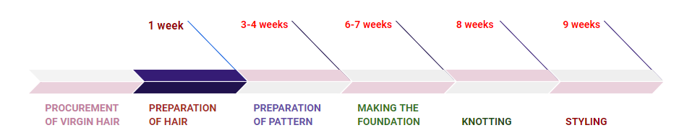
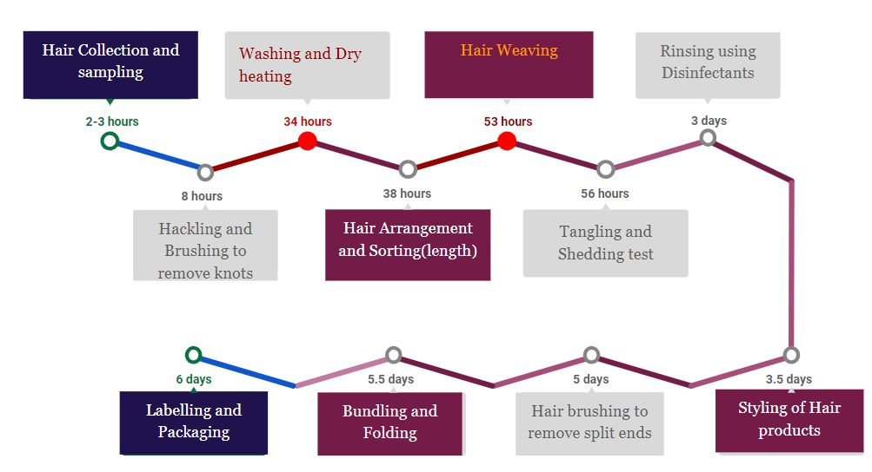
Overview
Our Product is to help in Automating the making of Hair Wigs with minimal human intervention . The product is focussed on Faster production and Safety of the Labourers .
We plan on doing this activity by integrating industrial robots
(Automated Guided Vehicles) and automation with the current structure of using labour without compromising on the quality of the final hair bundle.

Slide 4
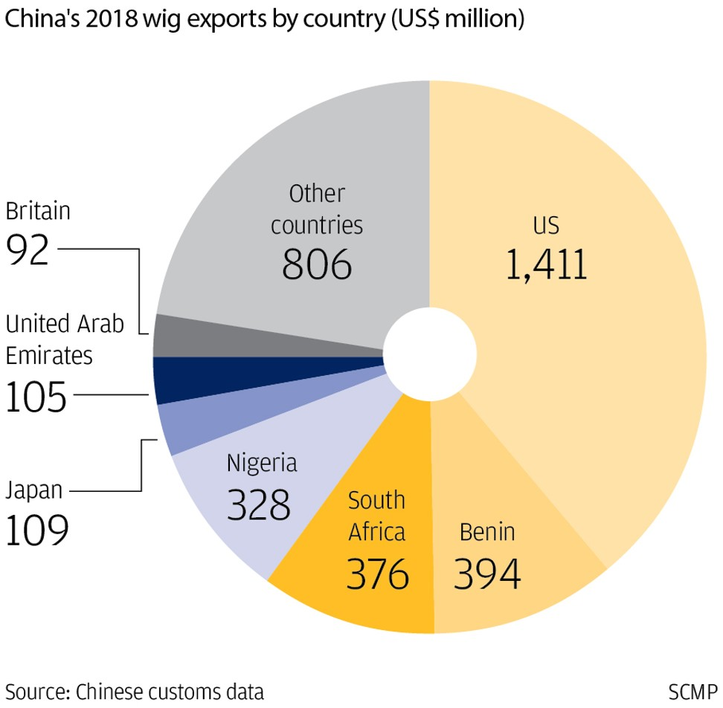
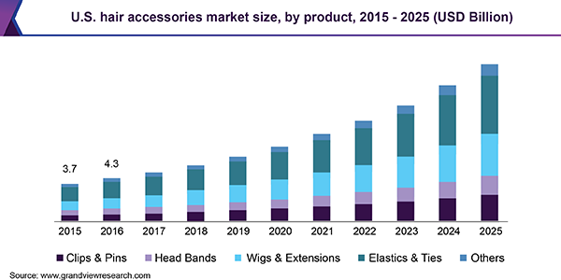
STATISTICS
Over the five years to 2020, industry revenue is projected to grow at an annualized rate of 1.8% to $390.6 million.
Africa is the second-largest destination for wigs, making up 37% of the overall market, just behind the US’s market share of 39%.

Slide 5
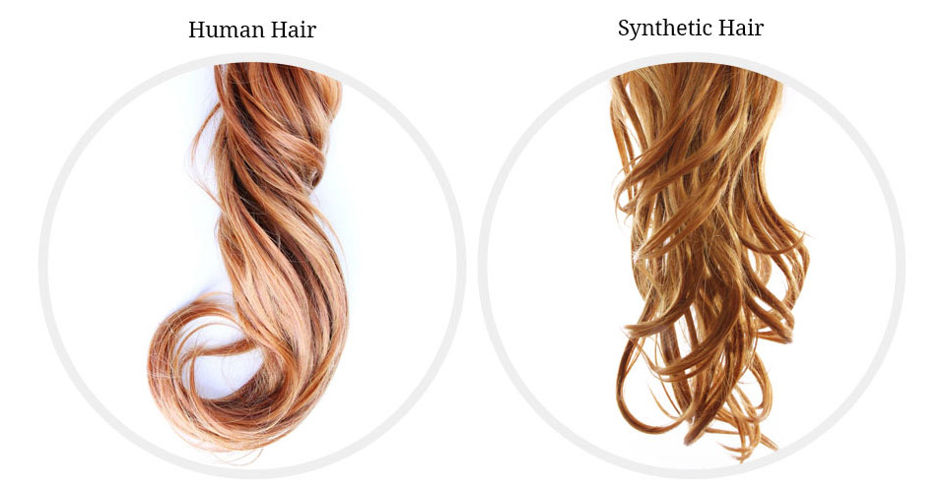
Human V/s Synthetic
Natural Hair | Synthetic Hair
Longevity | Low Maintenance
Styling Versatility | Easy Care
High Maintenance | Less Longevity
Color Variation | Less Versatility
Styling | Unnatural Shine

Slide 6
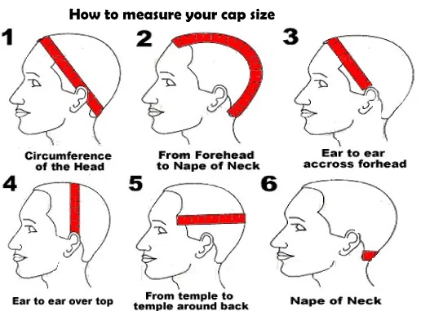
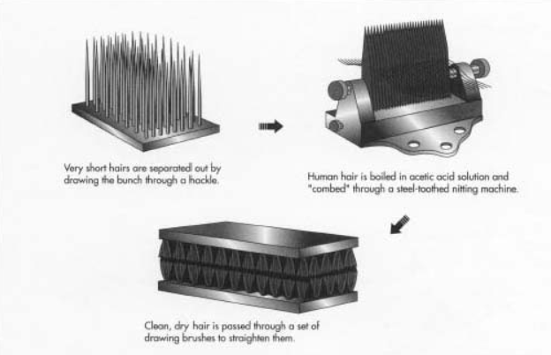
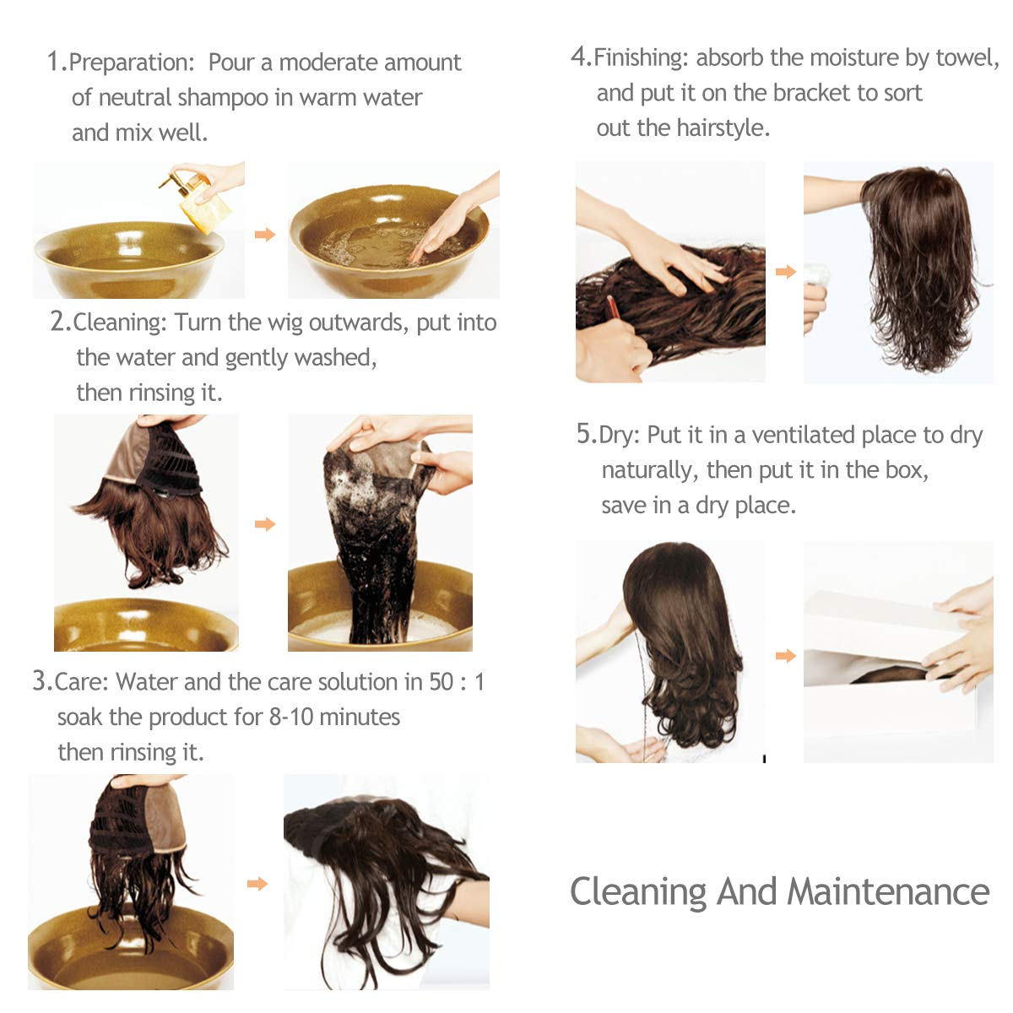
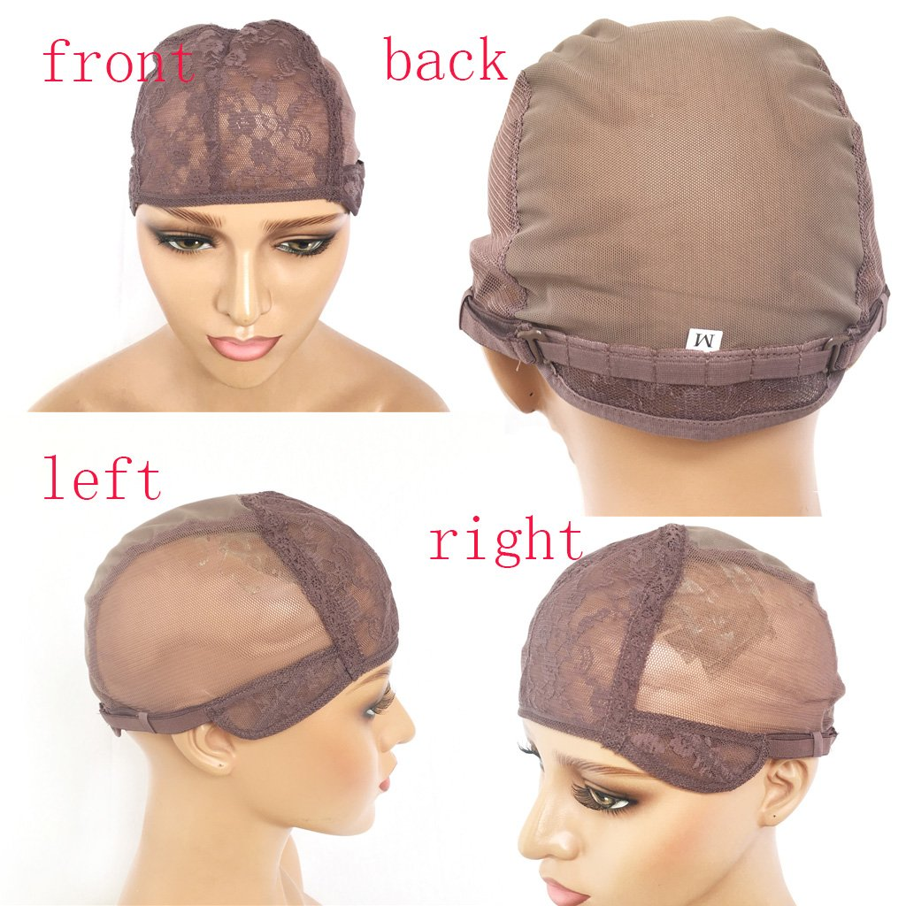
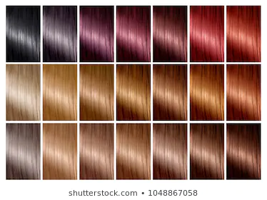
Current Methods in Hair Wig Manufacturing
1
Measurement
3
Hair Preparation
5
Cleaning and Maintenance
Foundation
Adding of Hair, Styling, Fitting
2
4

Slide 7
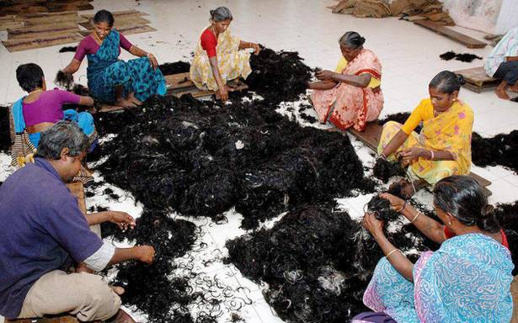
Disadvantages of Current System
Uncomfortable due to use of adhesives
Time Consuming Process due to segregation
Lack of Precision and Accuracy
Expensive
Custom Styling

Slide 8
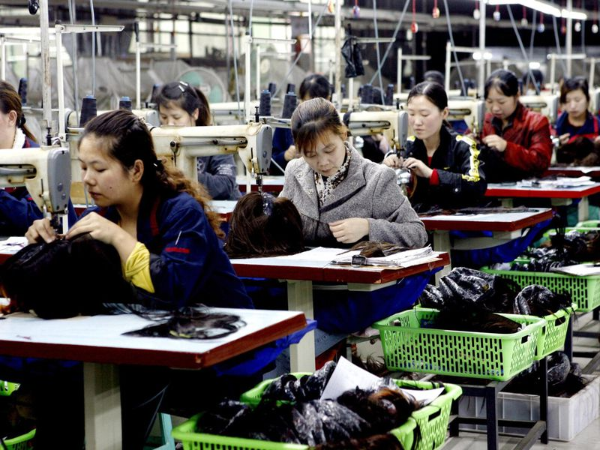
About Our Product:
We have focused on the preparation of hair sample and have split the procedural works into “8 BOOTHS” which are as follows:
Booth 1: Hair Collection, Sampling and Sorting
Booth 2: Hackling,Brushing and Sorting according to the Length
Booth 3: Washing and Dry Heating
Booth 4: Hair Weaving - Manual
Booth 5: Tangling, Shedding test and rinsing with disinfectants
Booth 6: Rinsing and basic styling of Hair samples
Booth 7 :Bundling and Folding- Manual (mainly for Quality Inspection)
Booth 8: Packaging

Slide 9
Manufacturing Line
Dedicated MCFMS
Open Field Layout

Slide 10
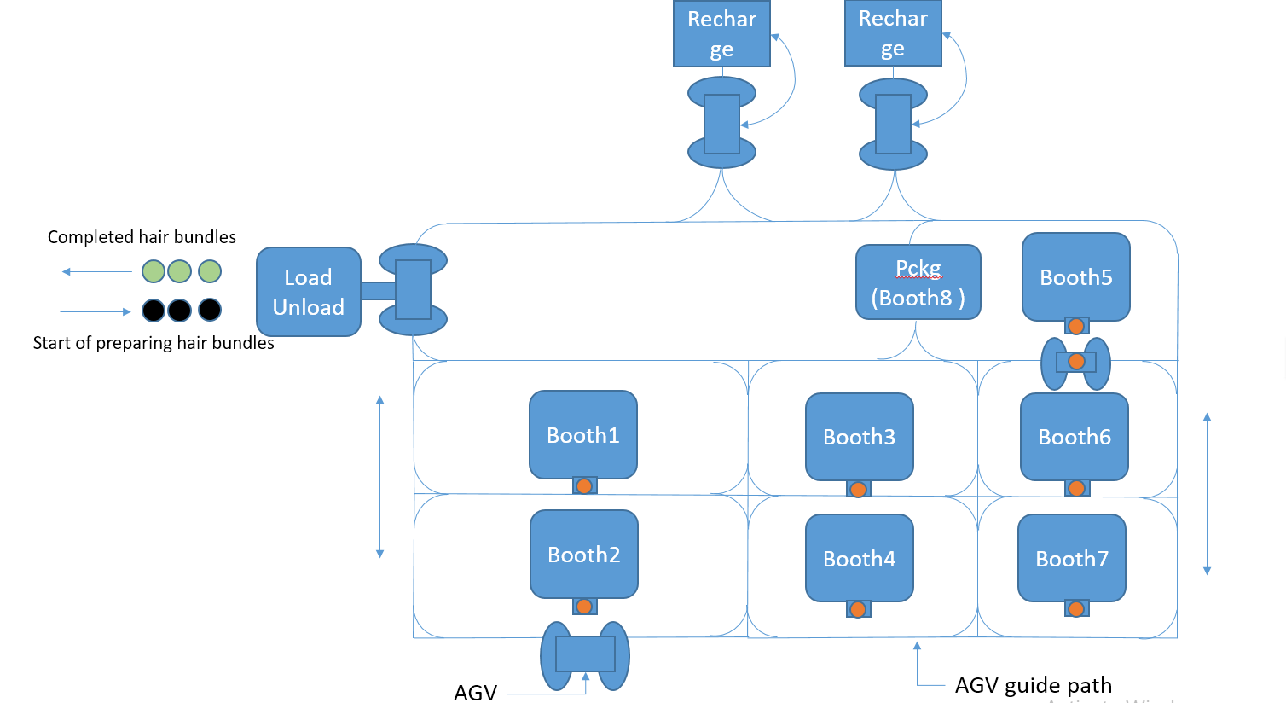
OPEN FIELD LAYOUT WITH INLINE GUIDELINES

Slide 11
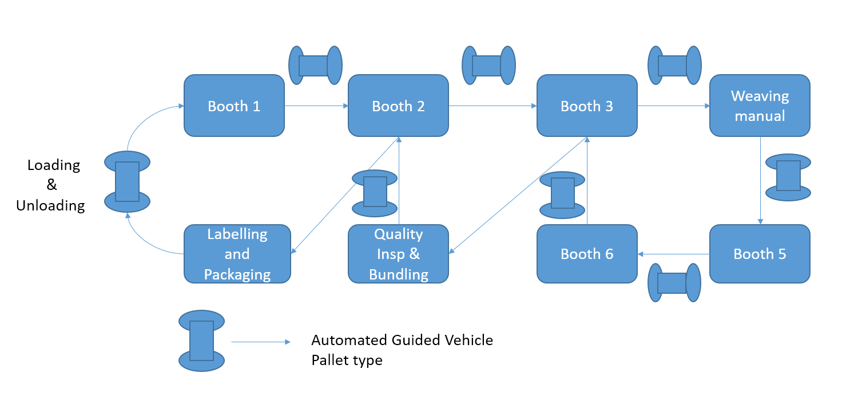
CHRONOLOGICAL ORDER OF PROCESSES

Slide 12
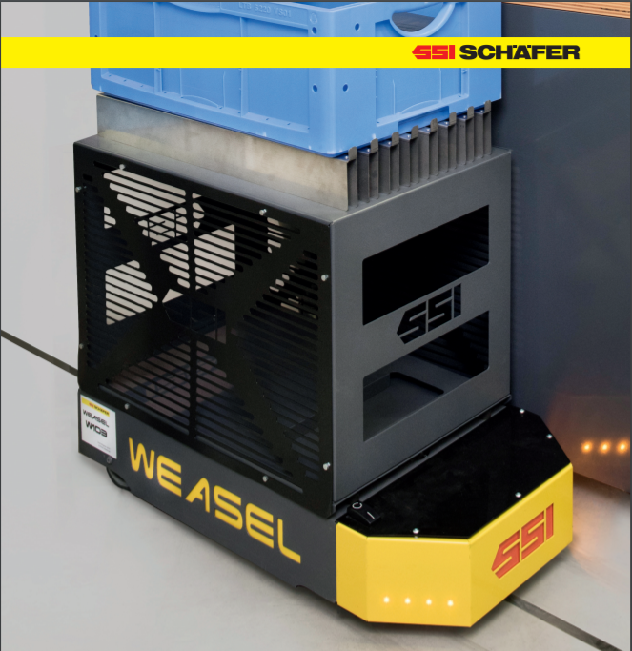
Automated Guided Vehicle:
As the weight to be carried by the AGVs are less than 35 kg, the type of AGV used is SSI Schaefer Weasel.
Some Agvs are accompanied with evaporator roller rods so that the wet hair is heated or dried while transporting.
The type of Navigation used is RFID tags
Turning radius of Weasel is 600mm
Speed of the weasel is a max of 1 m/s

Slide 13
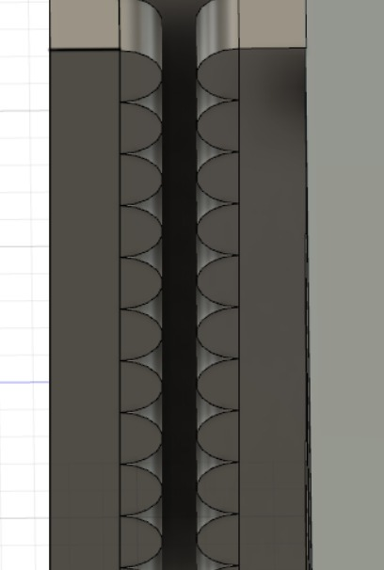
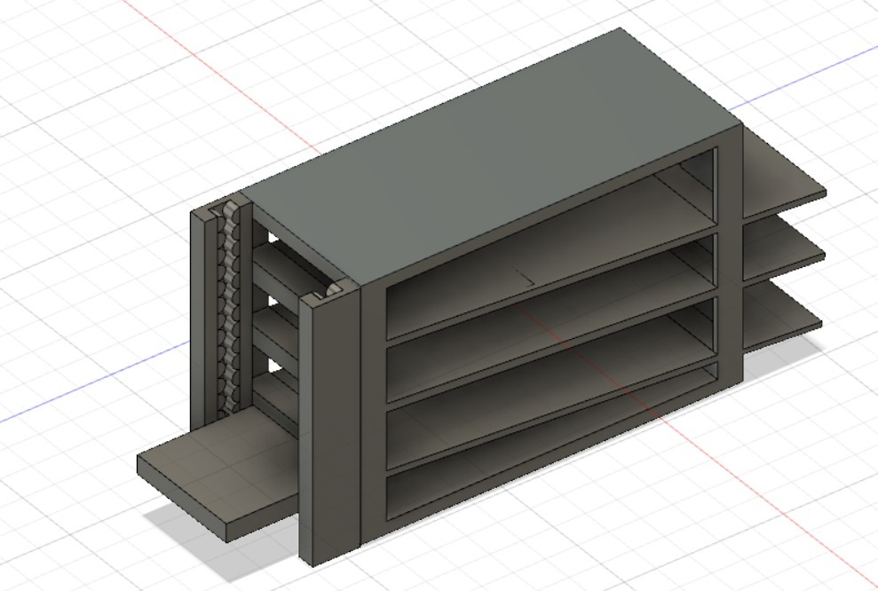
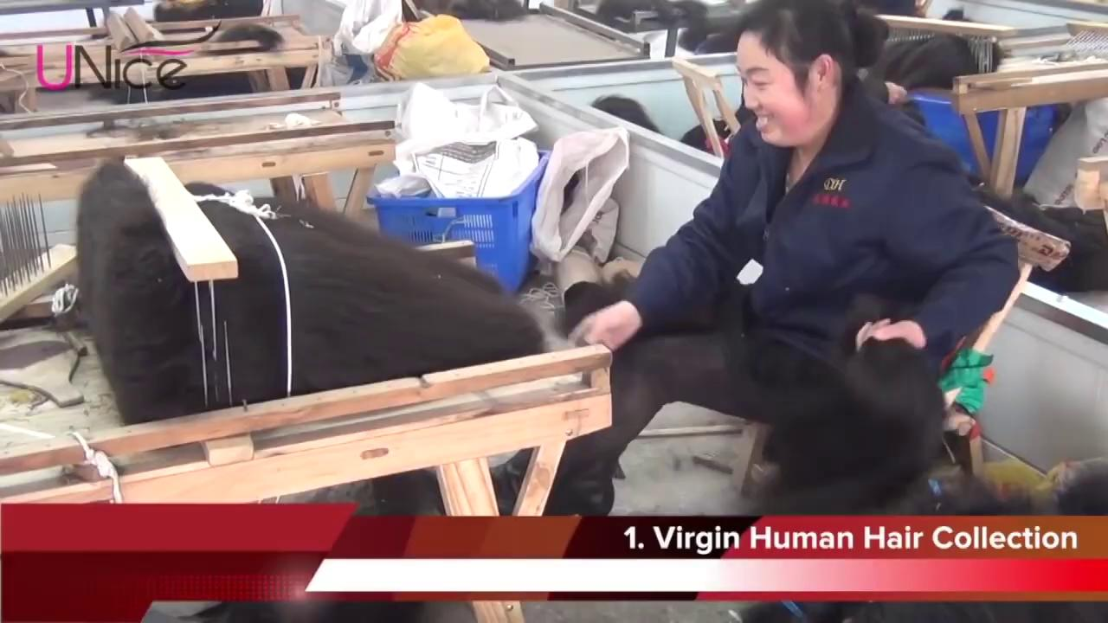
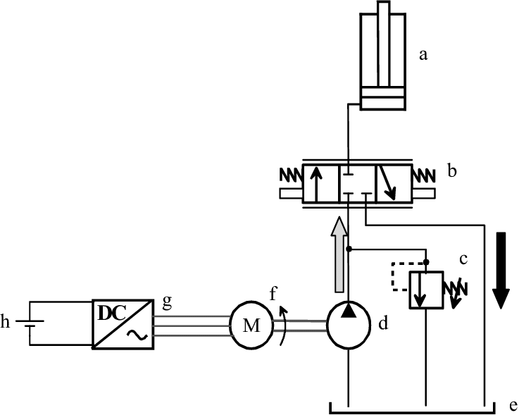
BOOTH 1 - Hair Collection, Sampling and Sorting
Current Method
Our Method
Hydraulic Circuit:
Used for lifting trays from ground to each level

Slide 14
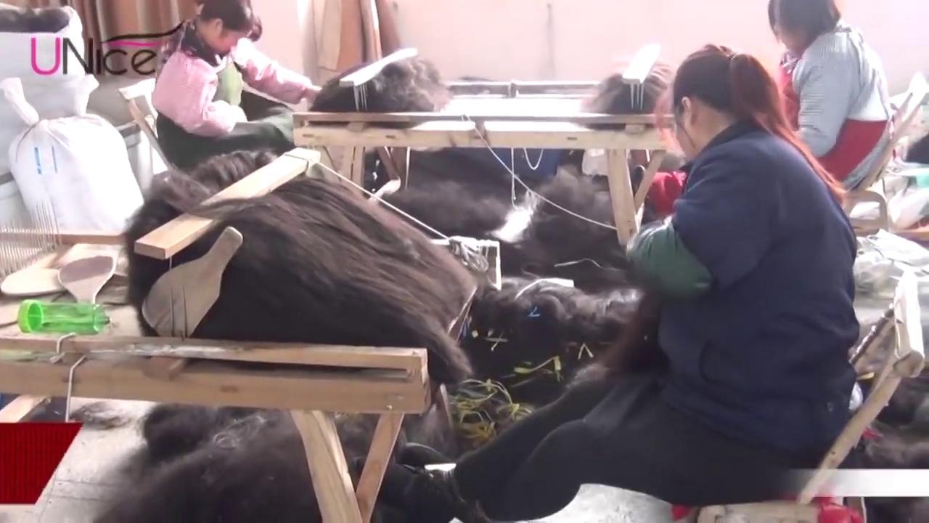
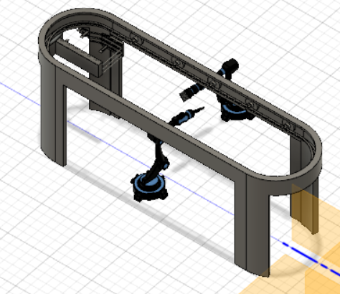
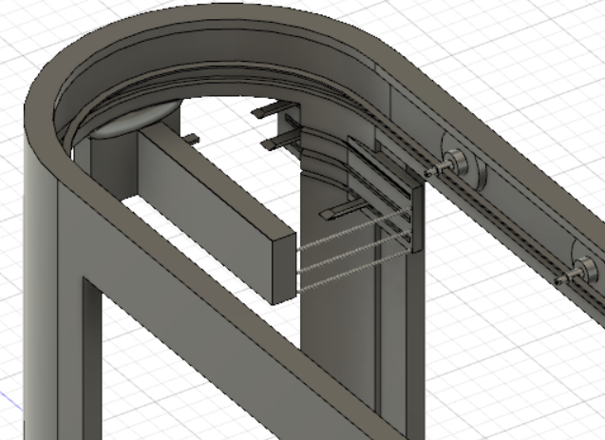
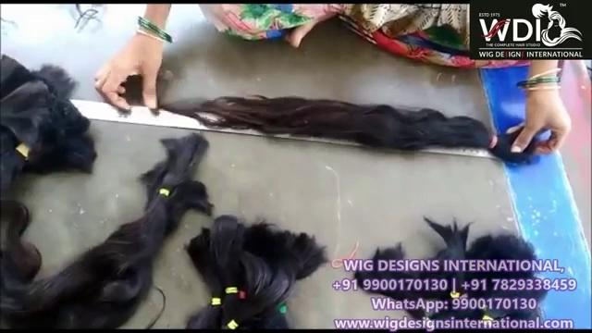
BOOTH 2 - Hackling, Brushing and Sorting according to the length
Current Method
Our Method
An overhead rotary conveyor belt which clamps the hair samples vertically and passes through the brushing/combing system and length measuring system for standardization.

Slide 15

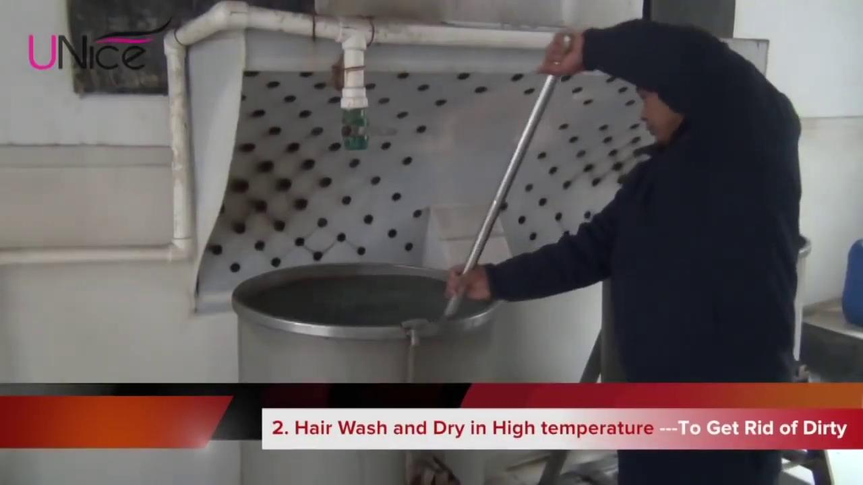
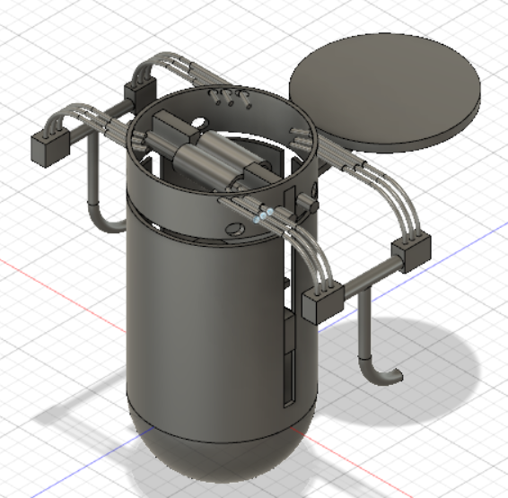
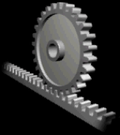
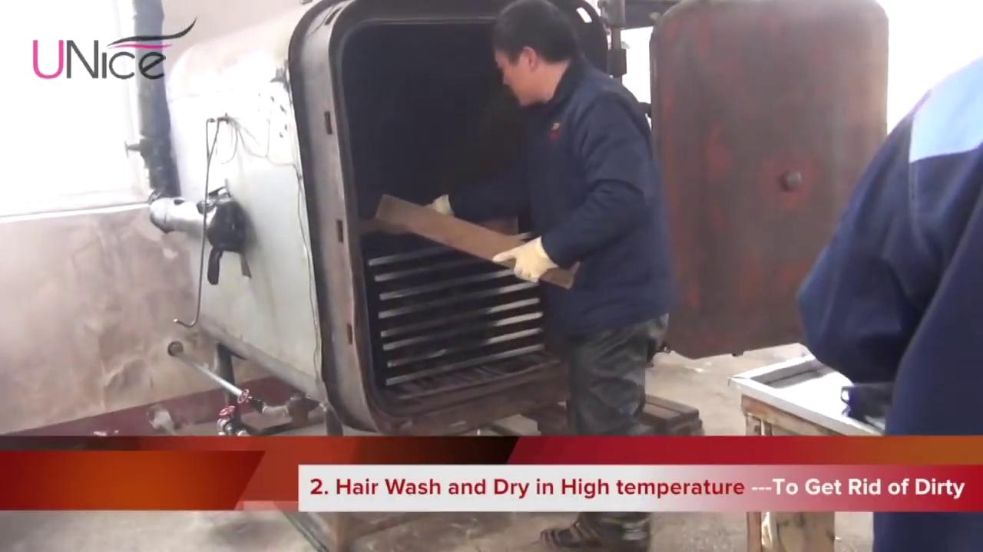
BOOTH 3 - Washing and Dry Heating
Current Method
Our Method
We combine the 2 processes by using a boiler with water jets at 10,2,4,8 o clock positions

Slide 16
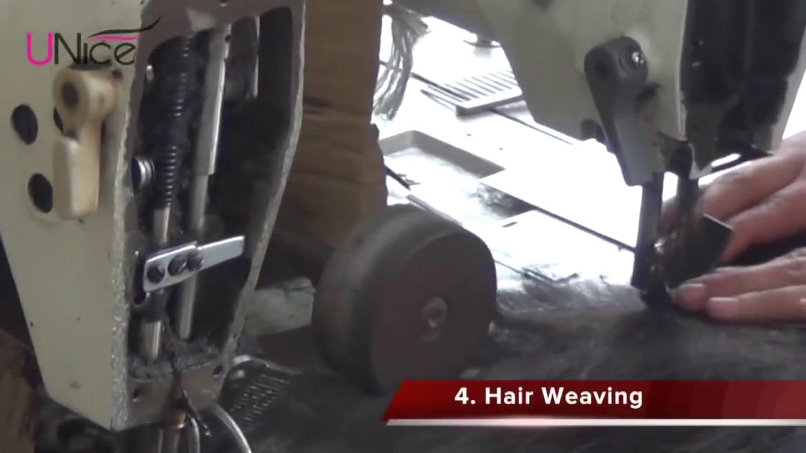
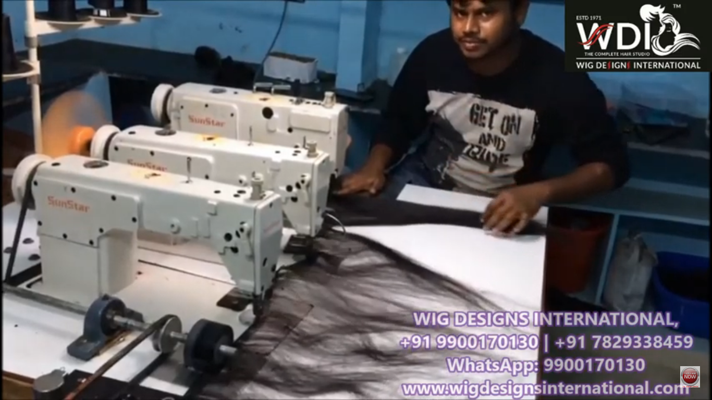
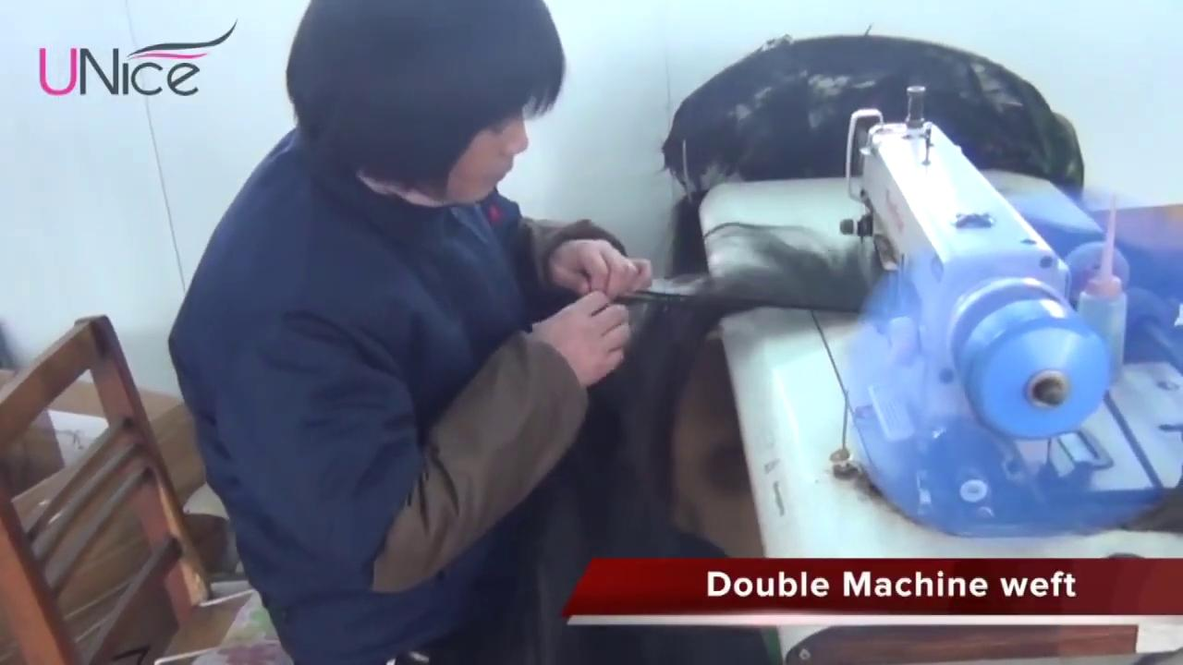
BOOTH 4 - Hair Weaving
Current Method
Three sewing machines placed in order where the labourer carefully provides the bundles of hair as input to create a durable triple weft which is a sewn hair bundle composed of 3 - 4 smaller hair bundles.

Slide 17
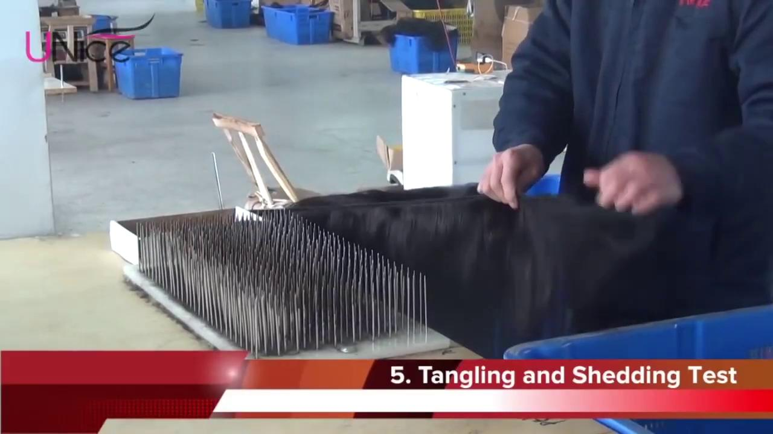
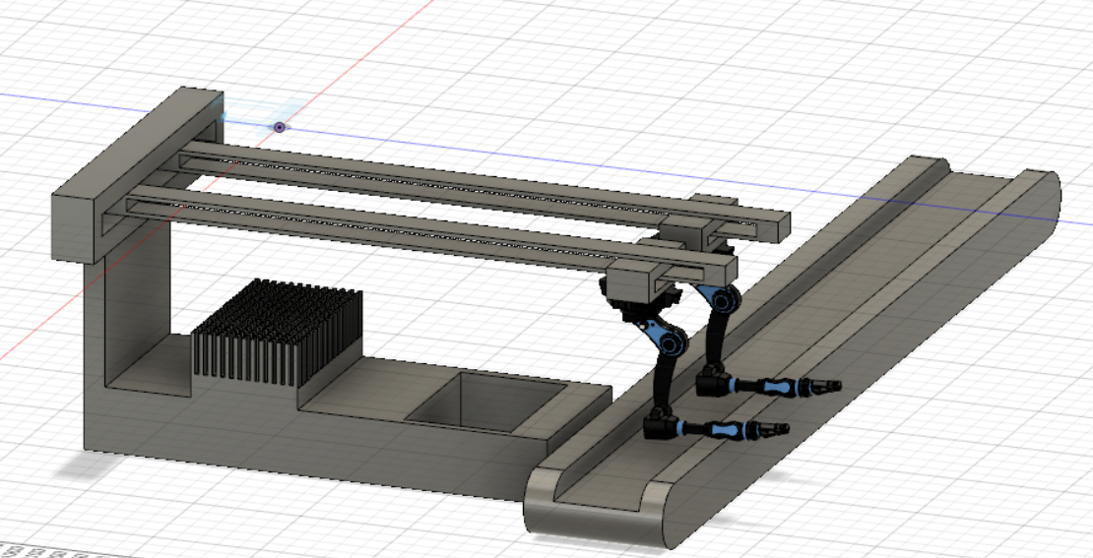
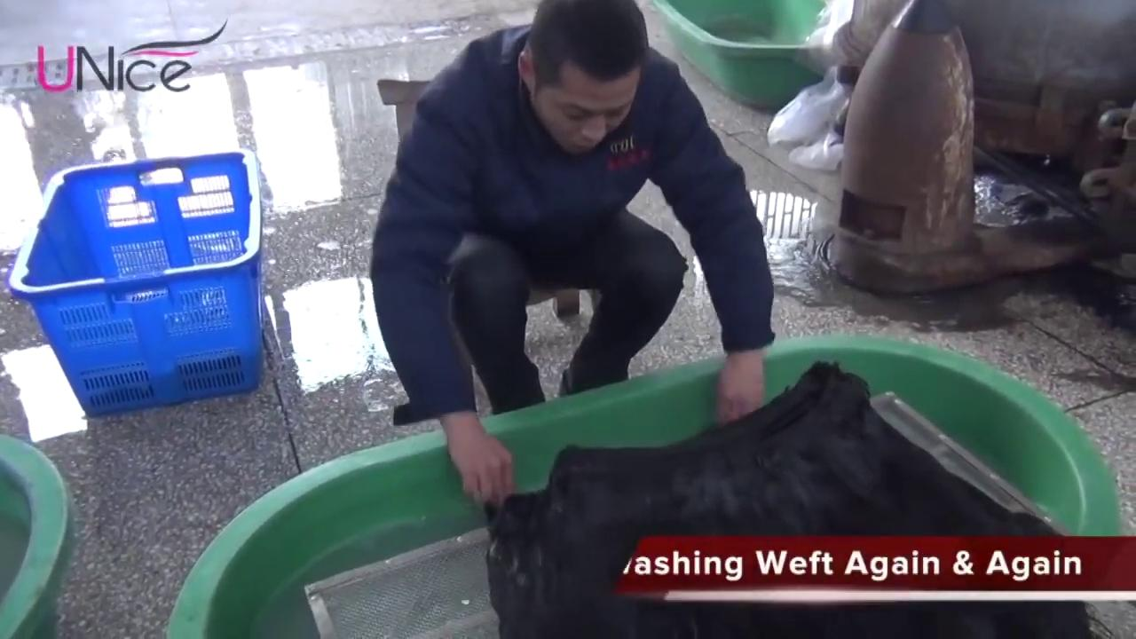
BOOTH 5 - Tangling, Shedding test and rinsing with disinfectants
Current Method
Our Method
2 robotic clamping arms clamp a hair bundle from the input tray and pass it through the needle bed to check for tangling and shedding. During its return motion the hair bundle is dipped and cleaned thoroughly before being placed on the conveyor belt.

Slide 18
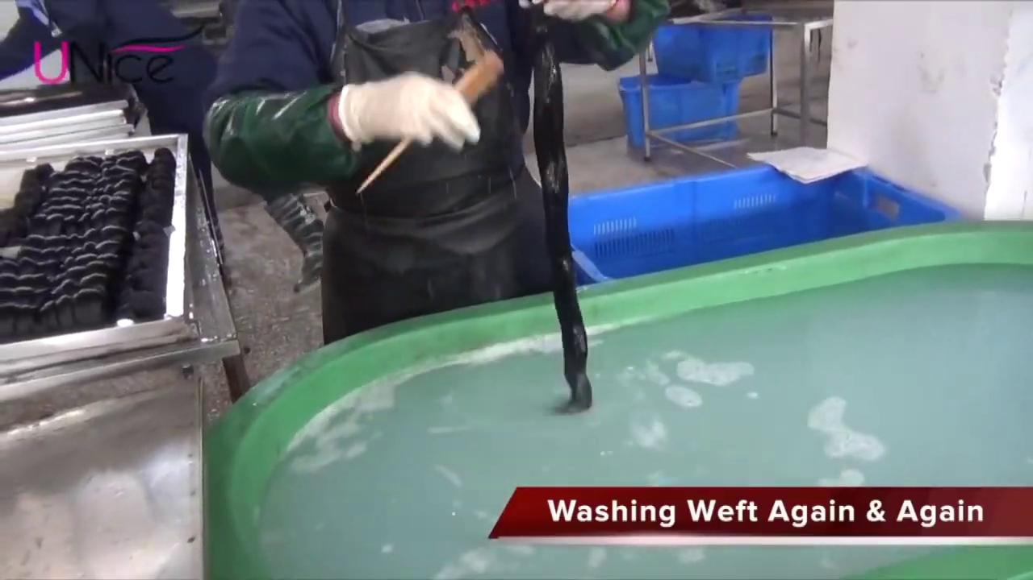
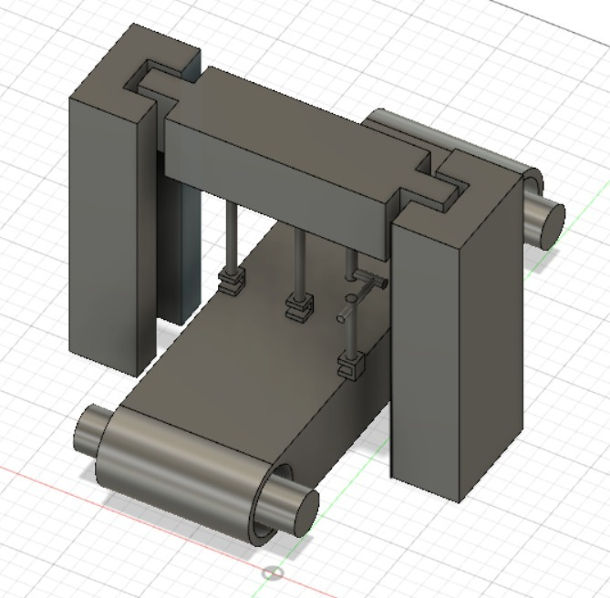
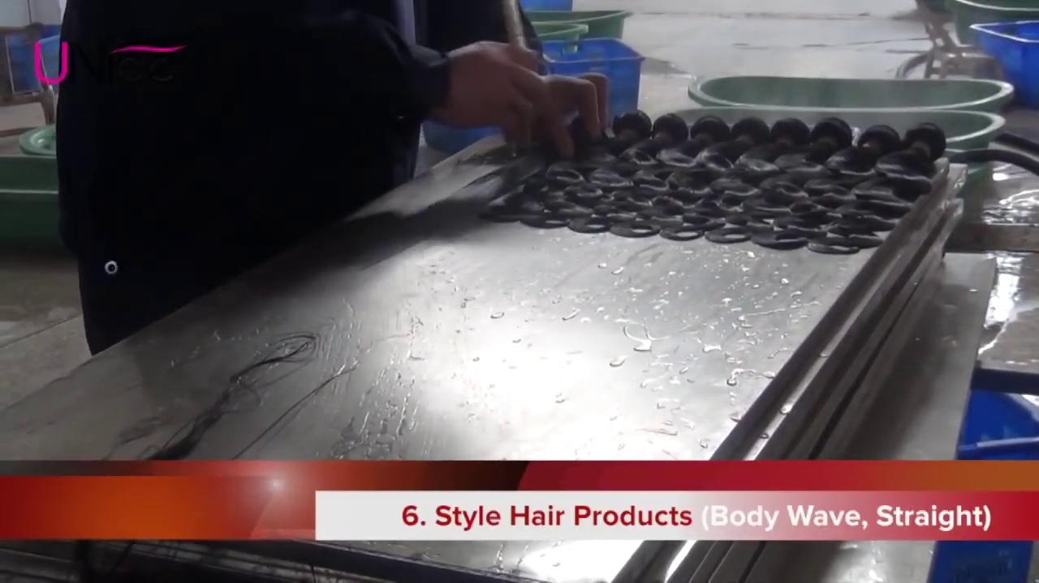
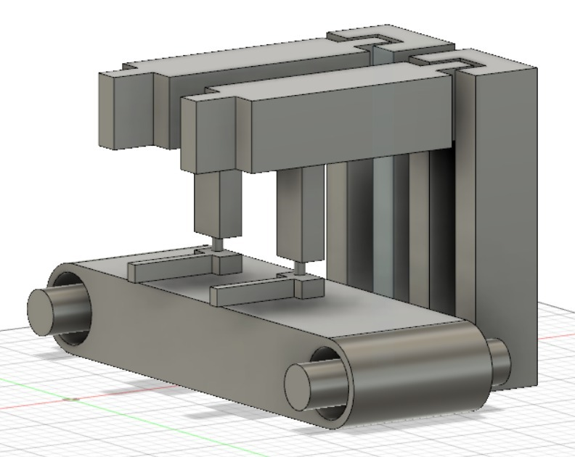
BOOTH 6 - Rinsing and Basic Styling of Hair Samples
Current Method
Our Method
The extended woven hair sample is to be folded before being rinsed using robotic clamps and metal plates. This samples is then straightened using brushes and styled using link constraints of kinematic 4R mechanism.

Slide 19
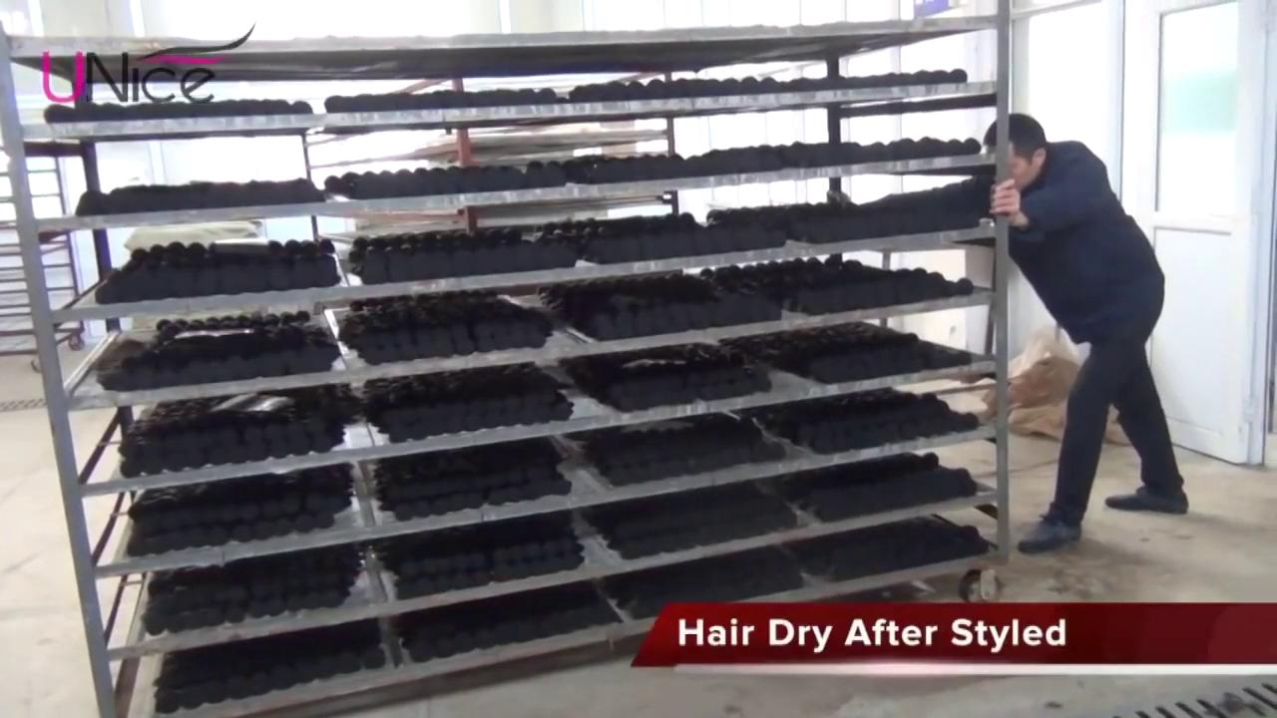
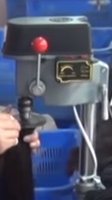
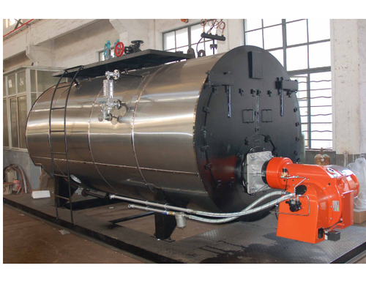
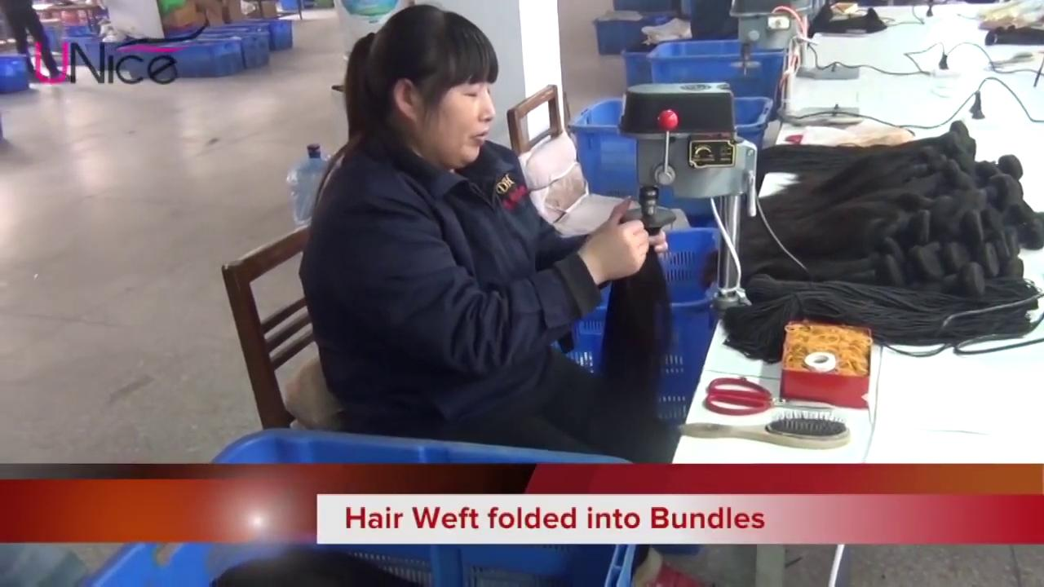
BOOTH 7 - Dry Heating and Bundling (Manual Inspection)
Current Method
Our Method
The hair samples are placed in an orderly fashion after straightening onto trays thereafter placed in dry heater manually for mass drying. Once this process is completed, manual inspection is done for quality and quantity and bundled using an existing rotary machine.

Slide 20
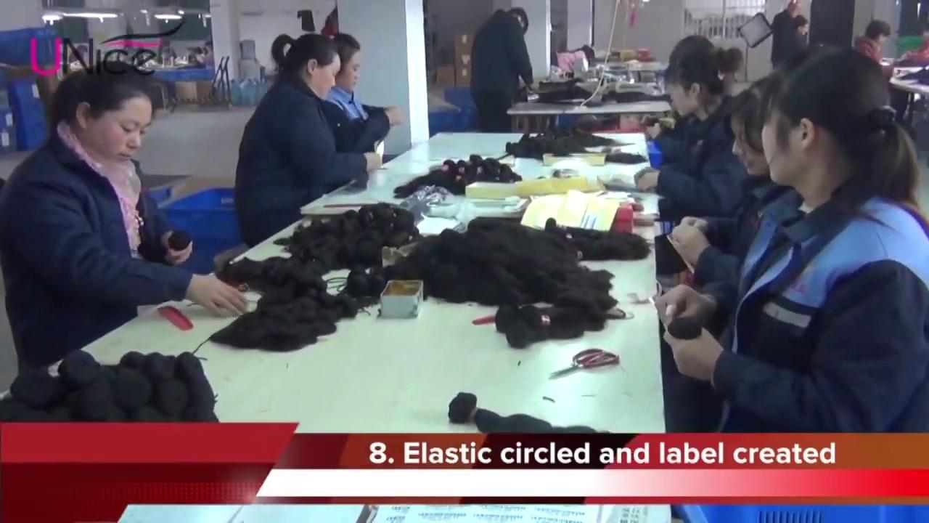
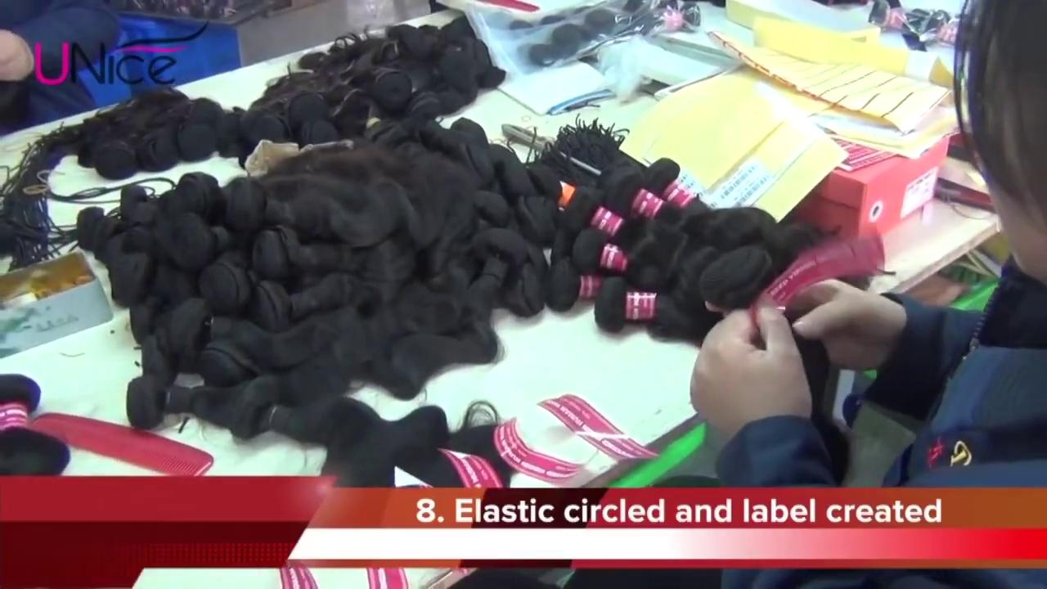
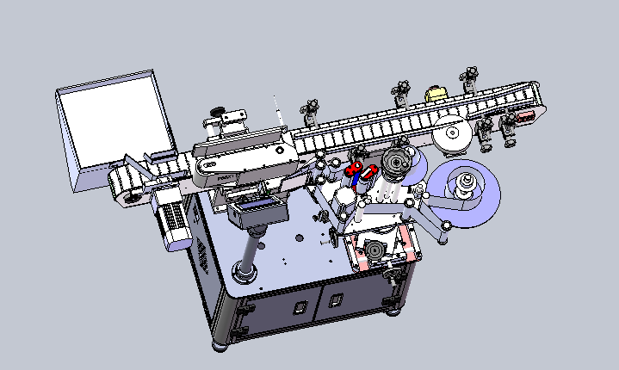
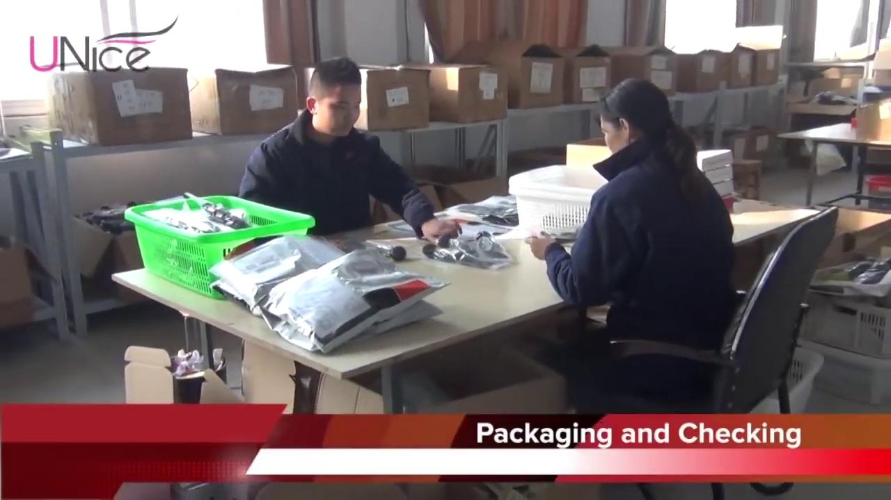
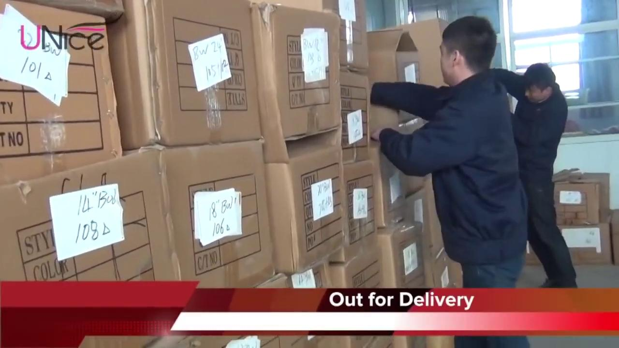
BOOTH 8 - Packaging
Current Method
Our Method
The cartons/ bundles after Booth 7 are sent back to Booth 2 for length Measurement and then sent to Booth 8 for packaging and labelling

Slide 21
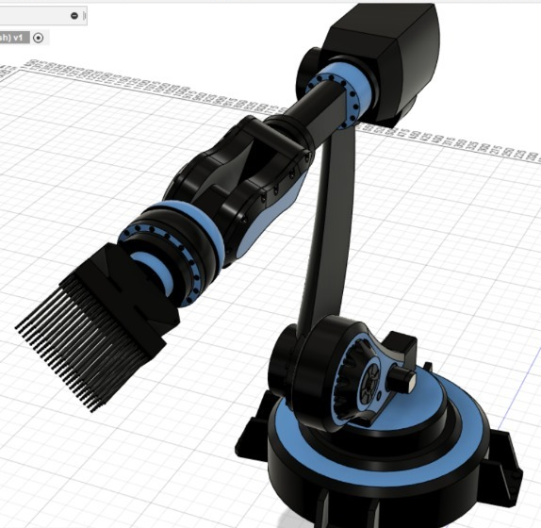
Satisfying Customer Needs - The New Line
Time Reduced from 1 week to 3 days.
Number of Batches increased per week
Cost of Manual labourers reduces drastically from 400 to approximately 40.
Utilisation of sensors for precision and accuracy
Mimicking Human Actions to the maximum
Capital Investment is high, ROI is also high
Booming Industry

Slide 22
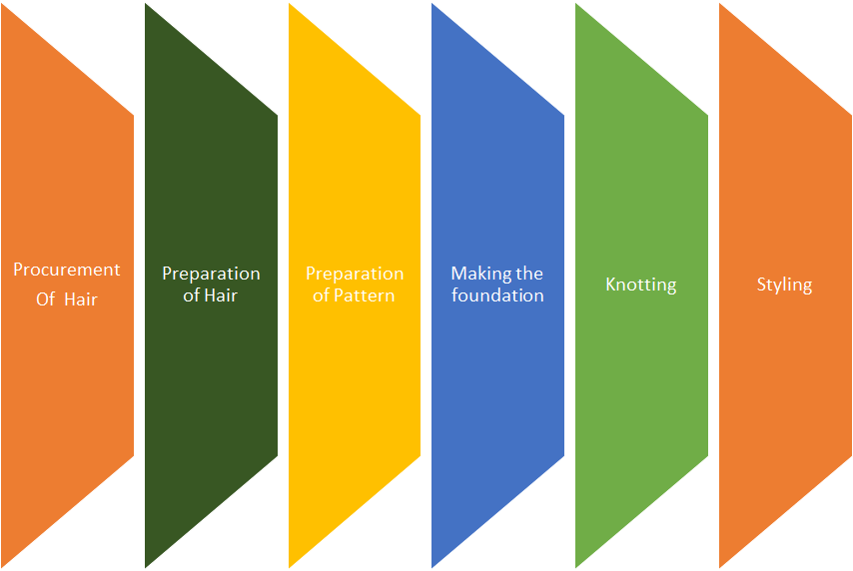
Future Expansion:
We are trying to create a robotic quality inspection system so that the quality of the hair bundles are checked every three processes before moving on to the next processes.
The weaving process is made automatic using industrial robot technology.
In near future we would automate Preparation of Pattern, making the Foundation, Knotting and Styling of hairs.

Slide 23

Vision
Manually Cumbersome Wig manufacturing
Automated quality Inspection
Fully Automated Hair wig Manufacturing
Automation in Hair Preparation
Automation in weaving and bundling
2022
2025
2020
2023
2030

Slide 24
Hair Fall is unavoidable.
Automation in Hair Wig
Manufacturing is inevitable.
Thank You :D

